Slide 1

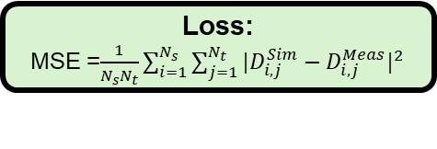


(c)
Inversion process
Initialization of Params
Forward model:
$D^{sim}$ = FEM(Params, Positions, Ts)
Observed Data:
$D^{Meas}$
Loss:
MSE =$\frac{1}{N_{s}N_{t}}\sum_{i=1}^{N_{s}}{\sum_{j=1}^{N_{t}}{{|D_{i,j}^{Sim}−D_{i,j}^{Meas}|}^{2}}}$
Inversion results:
${\text{Params}}^{∗}$
Yes
Convergent?
No
Params updating
by the L-BFGS-B algorithm

Slide 2



(c)
Inversion process
Initialization of $λ$
Forward model:
$D^{sim}$ = FEM($λ$, Pos, Ts)
Observed Data:
$D^{Meas}$
Loss:
MSE =$\frac{1}{N_{s}N_{t}}\sum_{i=1}^{N_{s}}{\sum_{j=1}^{N_{t}}{{|D_{i,j}^{Sim}−D_{i,j}^{Meas}|}^{2}}}$
Inversion results:
$λ^{∗}$
Yes
Convergent?
No
Params updating
by the L-BFGS-B algorithm

Slide 3
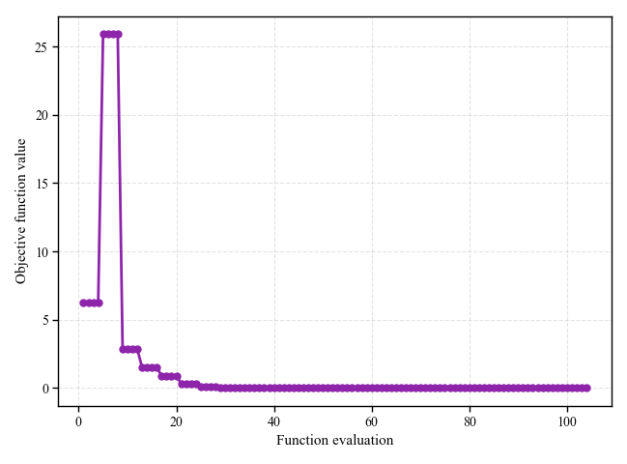
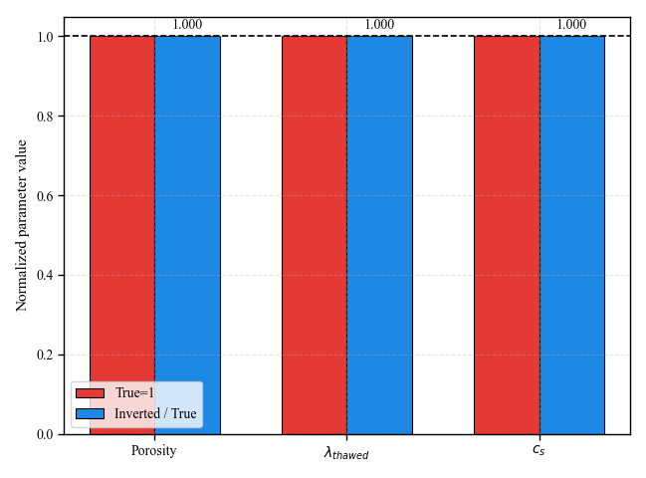
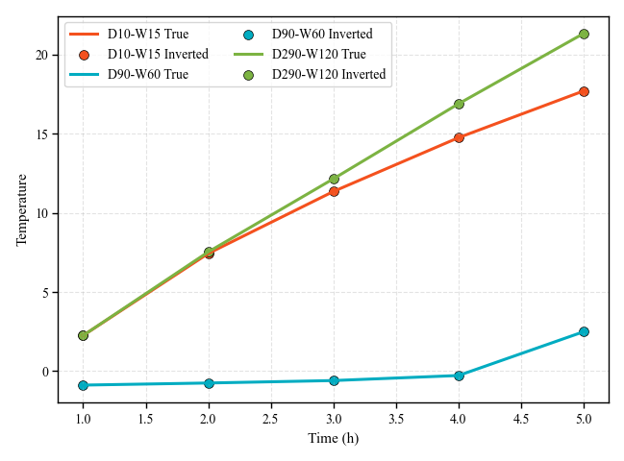
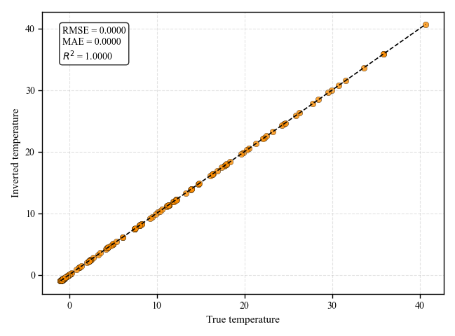
(a)
(b)
(c)
(d)

